Slide 1
WHAT ARE WE GOING TO DISCUSS TODAY…..???
EMBEDDED SYSYEMS
ARDUINO

Slide 2
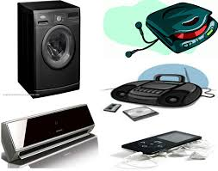
WHAT IS EMBEDDED SYSTEMS…???

Slide 3

AND WHAT ABOUT THIS???
IS THIS AN EMBEDDED SYSTEM?

Slide 4

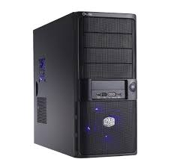
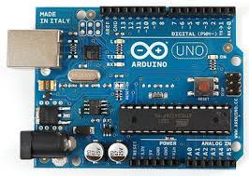
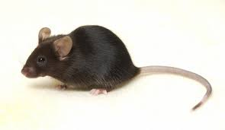
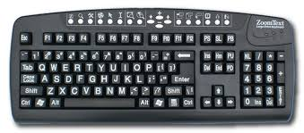
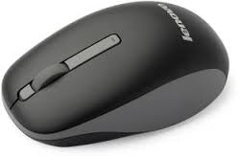
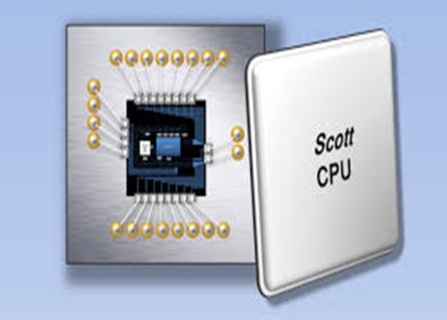
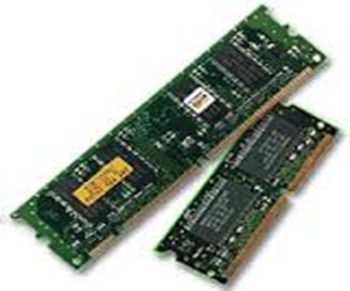

Slide 5
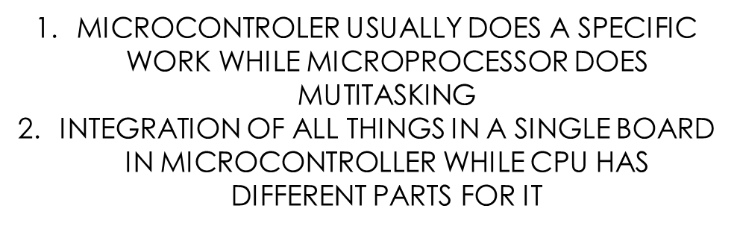
3. MICROCONTROLLERS ARE PORTABLE
4.THEY DIFFER IN POWER SYSTEM AND CLOCK SPEED.

Slide 6
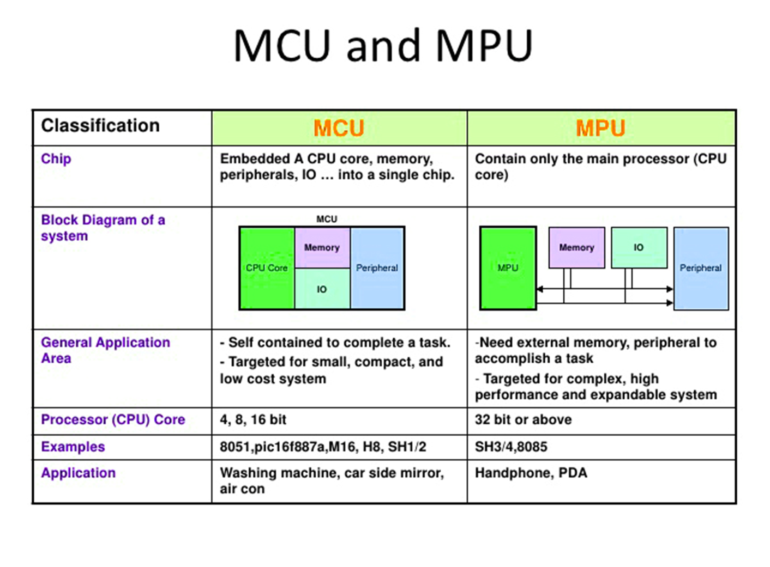

Slide 7
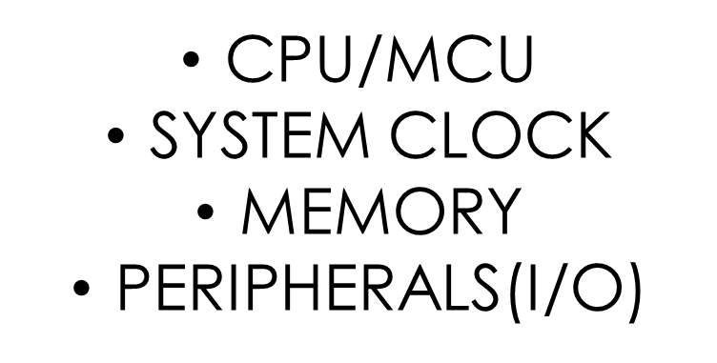

Slide 8
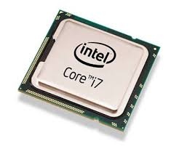
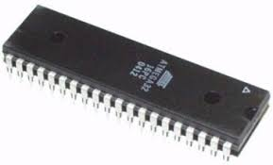

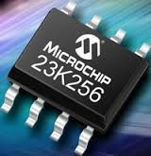
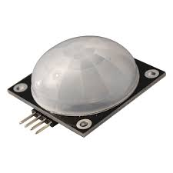
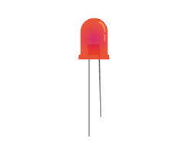
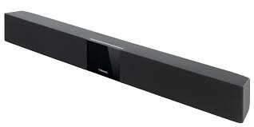
CPU
MCU
RAM
PERIPHERALS

Slide 9
HOW FAST YOUR SYSTEM RUNS…?
CLOCK SPEED
PARALLEL PROGRAMMING
DUAL CORE

Slide 10
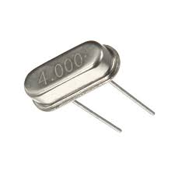
HOW FAST IS YOUR CLOCK…???

Slide 11
MICROPROCESSOR
HOW DOES IT WORK..???

Slide 12
LIST OF COMMON MICROCONTROLLER
Atmel(AT SERIES-INTEL)
Cypress Semiconductor
EPSON Semiconductor
Intel
Microchip Technology
NXP Semiconductors
Panasonic
Silicon Laboratories
Maxim Integrated
Spansion
STMicroelectronics
Texas Instruments

Slide 13
ARDUINIO

